Slide 1

Need of OS in Mobile
By Aashish Subedi

Slide 2
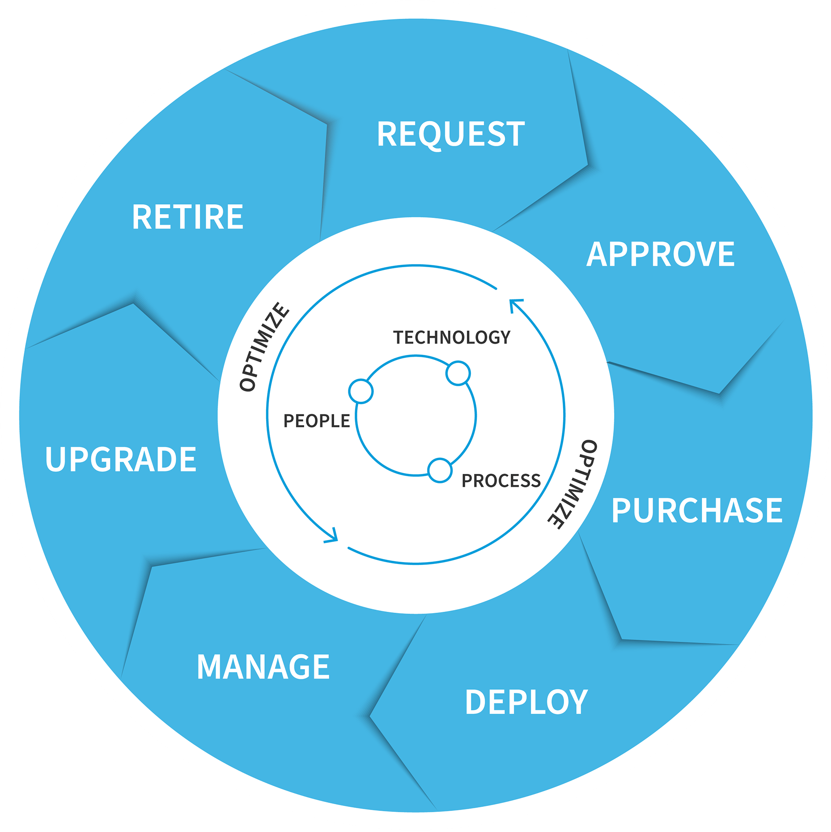

Agenda
Hardware Management
Hardware Management
Software Management
User Interface
Multitasking
Security
Software Management
Resource Allocation: Efficient distribution of CPU, memory, and storage to apps.
Power Management: Optimizing battery usage and power-saving modes.
Device Drivers: Communication with and control of hardware components.
Performance Monitoring: Tracking and maintaining hardware performance.
Security and Updates: Protecting hardware and managing firmware updates.
Application Installation: Facilitating the download, installation, and removal of apps.
Resource Allocation: Managing the allocation of system resources (CPU, memory) to apps.
System Updates: Handling software updates for the OS and apps to improve functionality and security.
Data Management: Organizing and managing app data and user files.
Security: Ensuring app integrity and protecting against malicious software.

Slide 3
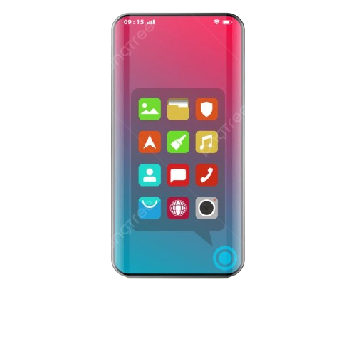

Hardware Management
Resource Allocation: Efficient distribution of CPU, memory, and storage to apps.
Power Management: Optimizing battery usage and power-saving modes.
Device Drivers: Communication with and control of hardware components.
Performance Monitoring: Tracking and maintaining hardware performance.
Security and Updates: Protecting hardware and managing firmware updates.
Software Management
Application Installation: Facilitating the download, installation, and removal of apps.
Resource Allocation: Managing the allocation of system resources (CPU, memory) to apps.
System Updates: Handling software updates for the OS and apps to improve functionality and security.
Data Management: Organizing and managing app data and user files.
Security: Ensuring app integrity and protecting against malicious software.

Slide 4


User Interface
Key features
User Experience: Simplifies navigation and interaction.
Accessibility: Makes the device usable for everyone.
Productivity: Enhances task efficiency.
Learning Curve: Easier for new users to learn.
Aesthetics: Improves visual appeal.
Multitasking
Run Multiple Apps: Use several apps at the same time.
Background Tasks: Apps can work in the background.
Efficient Resource Use: Smooth performance for all apps.
Boost Productivity: Quickly switch between tasks.
Manage Notifications:

Slide 5
Security
Thank You
Key features and points
Any questions ?
Data Protection: Safeguards personal and sensitive data.
App Security: Ensures apps are safe and free from malware.
User Authentication: Verifies user identity to prevent unauthorized access.
Encryption: Encrypts data to protect it from breaches.
Regular Updates: Provides updates to fix vulnerabilities and enhance security.

Slide 6
Hardware Management
Software Management
Any questions ?
Thank You

